Slide 1

Video Storyboarding
With:
Filming location:
Video type: | Publication Perspective discussing the article:

Slide 2
Editor’s notes
Please use this storyboard to plan your video., | The footage will be edited to a make a short video of under 10 minutes in length. The video can be filmed in sections (as per the chapters below) and will be edited into a continuous piece of film that will include chapter headings to make it easier for the user to follow. The video will be a question and interview style format, where the content is sectioned by questions (as title cards) followed by answers (the video script). The video should follow the same format and be similar in content to your original article as any additional unsubstantiated claims may mean your video does not pass editorial review. In each section, please indicate any figures or other visuals that you would like to incorporate. Where figures or tables are used from the original publication, appropriate permissions must be in place and the video will include acknowledgements to the original source of publication as stipulated by the original publisher. Please note our team will re-draw figures/tables for inclusion in the video so provisional versions of the images are required only. Please also indicate whether any animation is needed and the corresponding text the animation relates to (please note any animation will incur a charge). Once this storyboard has been submitted, the information will be reviewed to ensure it accurately represents the research being presented. The final storyboard will be used by our video team during production of the final video.

Slide 3


Title card
VIDEO TITLE
SPEAKER
Video Journal of Biomedicine (2024) doi.org/10.1080/vjbm-2024-XXXX
Editing notes:
Note from Editor: Please provide a headshot of the speaker. The image should be shared with the Editor as a separate .jpg, .png or .tif file.

Slide 4
Title card
This video is based on the following article(s)
ORIGINAL ARTICLE CITATION
Video Journal of Biomedicine (2024) doi.org/10.2217/vjbm-2024-XXXX
Editing notes:
Note from Editor: If the video is not based on a previous publication, this slide does not need to be included.

Slide 5
Abbreviations
ABBREVIATIONS:
Editing notes:
Note from Editor: Please list any abbreviations that you will use within the video

Slide 6
Introduction
Editing notes:
Note from Editor: Please introduce yourself and the paper being discussed (including the original article title and journal). This should be 50-150 words (filmed length up to 1 minute)

Slide 7
Question card
What was the purpose of this study?
SCRIPT
Editing notes:
Note from Editor: Suggest discussing the Introduction section. This should be 200-300 words (filmed length up to 2 minutes)

Slide 8
Question card
How was the study undertaken?
SCRIPT
Editing notes:
Note from Editor: Suggest discussing the Methods section. This should be 300-400 words (filmed length up to 3 minutes)
Here you might want to consider using a figure to support the text
Please indicate in the script when you will appear on screen and when you will be reading from the script (to coincide with a figure appearing on screen)

Slide 9
Question card
What were the results?
SCRIPT
Editing notes:
Note from Editor: Suggest discussing the Results section. This should be 300-400 words (filmed length up to 3 minutes)
Here you might want to consider using a figure to support the text
Please indicate in the script when you will appear on screen and when you will be reading from the script (to coincide with a figure appearing on screen)

Slide 10
Question card
What is the significance of these findings?
SCRIPT
Editing notes:
Note from Editor: Suggest discussing the Discussion section. This should be 200-300 words (filmed length up to 2 minutes)
Again please indicate any figures you would like to use (if any).
Please indicate in the script when you will appear on screen and when you will be reading from the script (to coincide with a figure/table appearing on screen)

Slide 11
Further reading
FURTHER READING: (optional)
Editing notes:
Note from Editor: Please include citations to be shared with audience (Max of 7)

Slide 12

Acknowledgements
ACKNOWLEDGEMENTS:
Editing notes:
Note from Editor: Please list any co-authors and contributors that worked on the video and specify their contributions (as detailed in your Author Disclosure form). Please also include any other acknowledgments.

Slide 13
Disclosure Statements
DISCLOSURE STATEMENTS:
Editing notes:
Note from Editor: Please include any disclosure statements relevant to the original study and to the speaker. The statements should cover the information included in the Author Disclosure form.

Slide 14
Disclaimer
DISCLAIMER:
This video is a video summary of a recent peer-reviewed publication. The video has been reviewed for the purpose of representativeness to the original publication only. Viewers are referred to the original publication for further details on the peer-review process, author disclosures, relevant funding and other pertinent information.
© The Authors
Editing notes:
Note from Editor: Please either update the name of the copyright holder or use “The Authors”

Slide 15
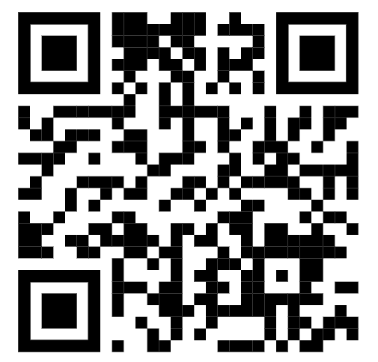
QR code
Scan the QR code to read
the original article:
Reference for the original article
Editing notes:
Note from Editor: Please include a QR code that links to the original publication. If the video is presenting a clinical trial, please include the registration number + link to the website, e.g. "Clinical Trial Registration: NCT12345678 (clinicaltrial.gov)“, below the reference. If the video will not be based on a previous publication, the QR code does not need to be included.

Slide 16



Closing
FOLLOW US ON:
OR VISIT US AT:
WWW.BIOMEDICINE.VIDEO

